Slide 1

Introduction to Economics

Slide 2


Introduction to Economics
Because our income is scarce, we must make choices when deciding how to spend our limited income.
Economics is the study of how we make those choices and the different factors we should take into account before deciding what we should spend our money on in order to satisfy as many of our needs and wants as possible.

Slide 3

Opportunity Cost
As a result of satisfying some of our needs and wants with our limited income, there will be other needs and wants that we choose not to satisfy because we cannot afford to do so.
In Business Studies, we refer to the item we decide not to buy because we cannot afford it as the opportunity cost of the item we actually did buy.

Slide 4
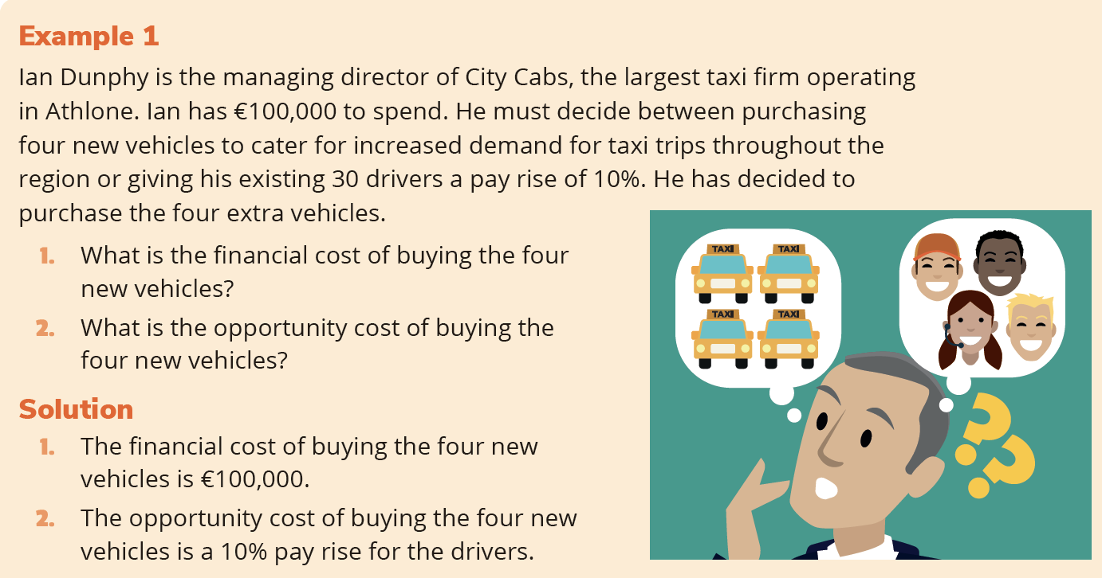
Opportunity Cost
Opportunity Cost

Slide 5
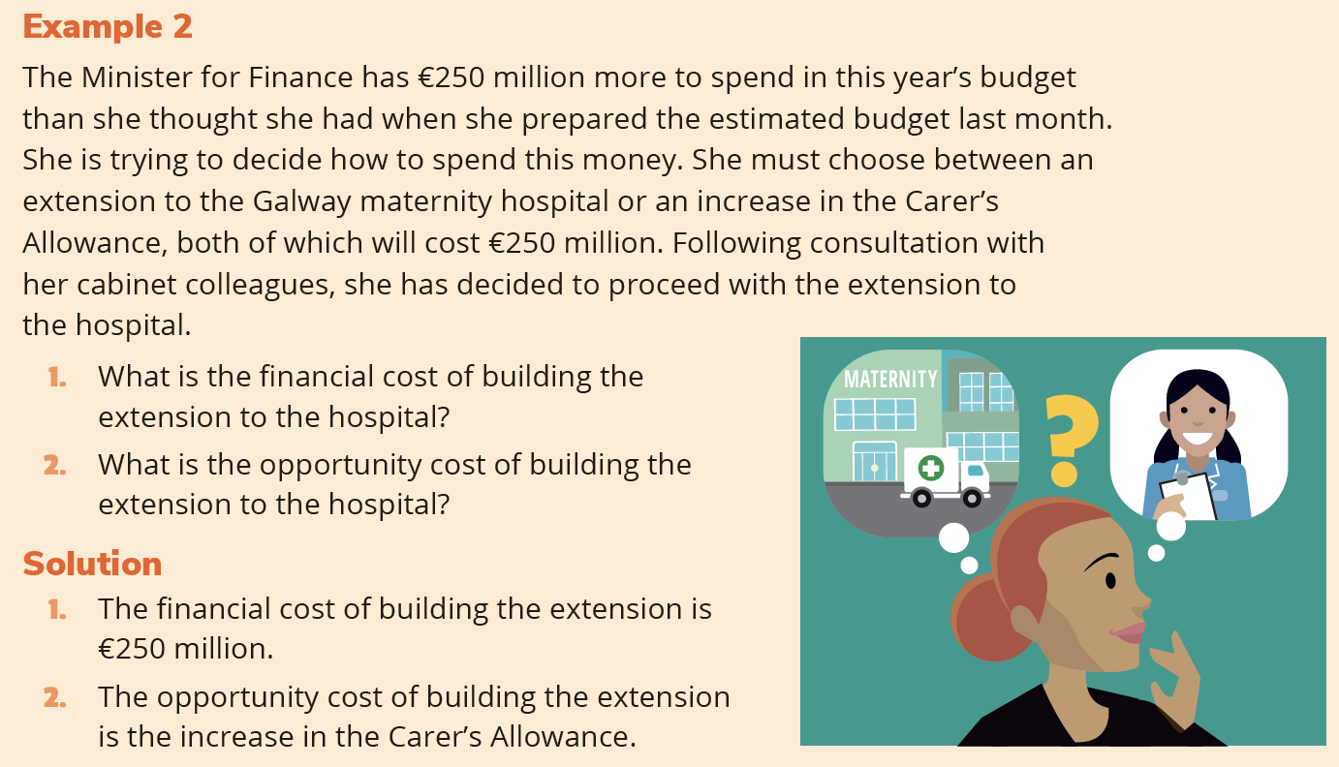
Opportunity Cost

Slide 6
Opportunity Cost
How to Choose
When deciding how to spend our limited resources (income), the two main questions to consider are:
What are our priorities? Our priorities are the items of expenditure that must be paid.
What areas of spending will give us the greatest benefit or return?

Slide 7
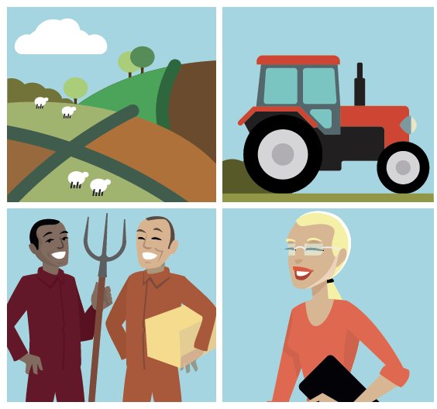
Factors of Production
Factors of production are the economic resources necessary to produce goods and services. They can be divided into four categories: land, labour, capital and enterprise.
Each factor of production should be a source of income to the person who provides it. For example:
Land yields rent
Labour (workers) receives wages
Capital earns interest
Enterprise makes profit (hopefully!)

Slide 8
Factors of Production
Land
All the natural resources available in a country that can be used to produce goods and services, for example agricultural land, mines, forests, seas, rivers and lakes.
Labour
The people available in a country to help produce goods and services and the qualifications and skills they have, for example plumbers, technicians, pilots, teachers, architects and receptionists.
Capital
All the man-made things that are available to help in the production of goods and services, for example machinery, vehicles, buildings and equipment.
Enterprise
The act of bringing together land, labour and capital to set up a business to produce a product or supply a service at a profit. The person who displays enterprising qualities in a business is known as an entrepreneur.

Slide 9
Consequences of Making Choices
When we are making decisions about how to spend our scarce resources, we must look at all of the possible consequences of the decisions we make. We should look at:
The financial cost
The opportunity cost
The benefits to the organisation or household
The benefits to society
Any additional costs that will be incurred by us as a direct result of the original purchase
The costs to society

